Slide 1
Chapter 9 counters
计数器

Slide 2
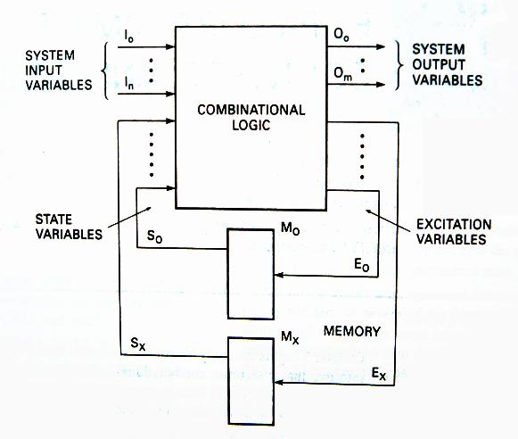
输出方程
O=f₁(I,S)
激励方程
E=f₂(I,S)
状态方程
S_{t+1}=f₃(E,S_{t})
存储元件：FF

Slide 3
Sequential Circuit Models

Slide 4
Sequential Circuit Models
E=f(S_{t})
S_{t+1}=f(S_{t},E)
O=g(S_{t})
Simple sequential counter model

Slide 5
Sequential Circuit Models
E=f(I, S_{t})
S_{t+1}=f(S_{t},E)
Moore sequential circuit model
O=g(I,S_{t})
Mealy sequential circuit model
O=g(S_{t})

Slide 6
Sequential Circuit Models
Mealy model:
Both outputs and next state depend both on primary inputs AND present state.
Moore model:
Only next state depends directly on primary inputs AND present state. Outputs depend only on present state.

Slide 7
Input variable
Output variable
State variable
Excitation variable
State
State variables and states are related by the expression:
2^{x}=y
State variables
states

Slide 8
Counters
A counter is a register that goes through a predetermined sequence of states upon the application of clock pulses.
Counters are categorized as:
Asynchronous counter: The FF output transition serves as a source for triggering other FFs. No common clock.
Synchronous Counter: All FFs receive the common clock pulse, and the change of state is determined from the present state.

Slide 9
Counting in Binary
Toggle?
0 | 0 | 0
0 | 0 | 1
0 | 1 | 0
0 | 1 | 1
1 | 0 | 0
1 | 0 | 1
1 | 1 | 0
1 | 1 | 1

Slide 10
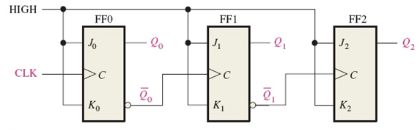
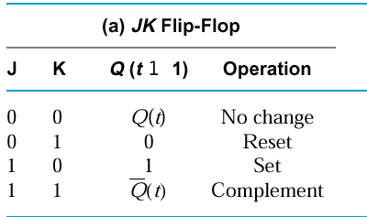
Three bit Asynchronous Counter 三位异步计数器
In an asynchronous counter, the clock is applied only to the first stage. Subsequent stages derive the clock from the previous stage.

Slide 11
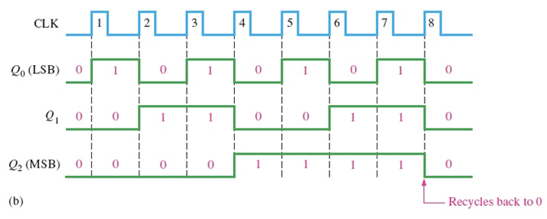

Three bit Asynchronous Counter
Notice that the Q₀ output is triggered on the leading edge of the clock signal. The following stage is triggered from $\overline{Q_{0}}$.

Slide 12
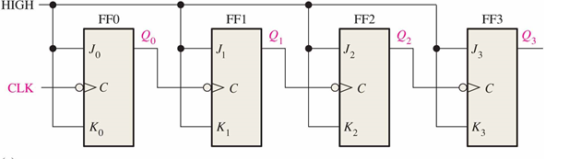
Four bit Asynchronous Counter
A 4-bit Upward Counting Ripple Counter with negative edge-triggered J-K flip-flop: Counting from 0000~1111
How about 5-bit? 6-bit?

Slide 13
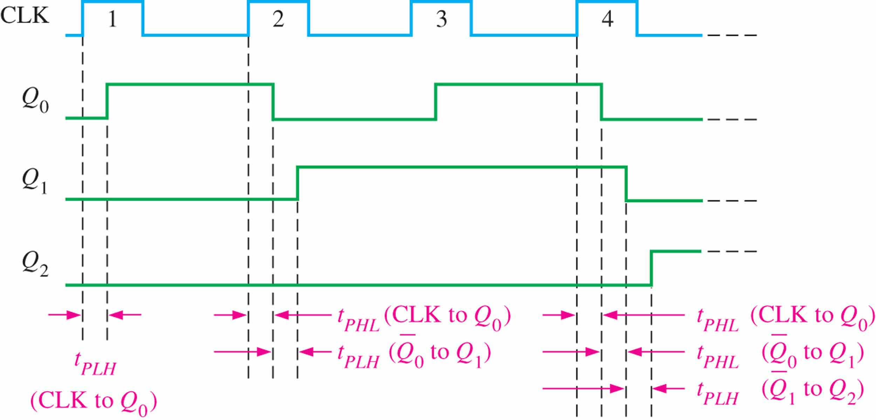
Propagation Delay* 传输延迟
Asynchronous counters are sometimes called ripple counters, because the stages do not all change together. For certain applications requiring high clock rates, this is a major disadvantage.
Notice how delays are cumulative as each stage in a counter is clocked later than the previous stage.

Slide 14
Modulus-N Counters
The modulus of a counter is the number of unique states through which the counter will sequence.
计数器的模是计数器按顺序经过的独特状态的数目。
The maximum possible number of states (maximum modulus) of a counter is 2^{n}, where n is the number of flip-flops in the counter.
包含n个触发器的计数器的最大可能状态是2^{n}。

Slide 15
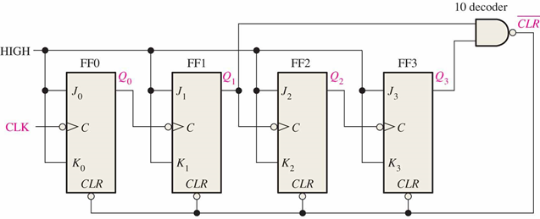
Asynchronous Decade Counter 异步十进制计数器
This counter uses partial decoding to recycle the count sequence to zero after the 1001 state. Other truncated sequences(截断序列) can be obtained using a similar technique.
WHY？

Slide 16
Asynchronous Decade Counter
One way to truncate the sequence is to decode ten (1010) with an active-low output.
Partial Decoding(部分译码): the two unique states(Q₁=1 and Q₃=1) are sufficient to decode the count of ten.（Verify it with K-map. Hint: don’t care condition)

Slide 17
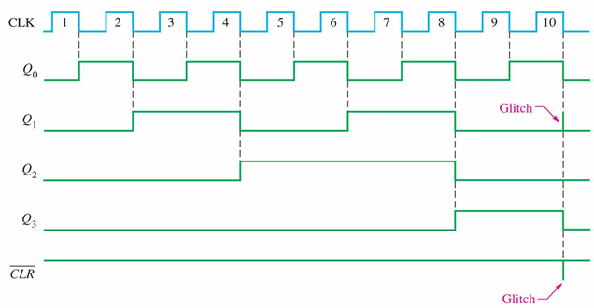

Asynchronous Decade Counter
When Q₁ and Q₃ are HIGH together, the counter is cleared by a “glitch(毛刺)” on the $\overline{CLR}$ line.

Slide 18

design a asynchronous module-K counter: Counting from 0 to K-1
1. Choose the type of flip-flops
2. Decide the number of flip-flops: 2^{n-1} < K ≤ 2^{n}
3. Let all the flip-flops recycle back to 0 after the K-1 state.
1) K=2^{n}
2) K<2^{n}. Decode K with logic gates and use it to truncate the sequence(the $\overline{CLR}$ line) .
Verify it with Example 9-2 P.295

Slide 19
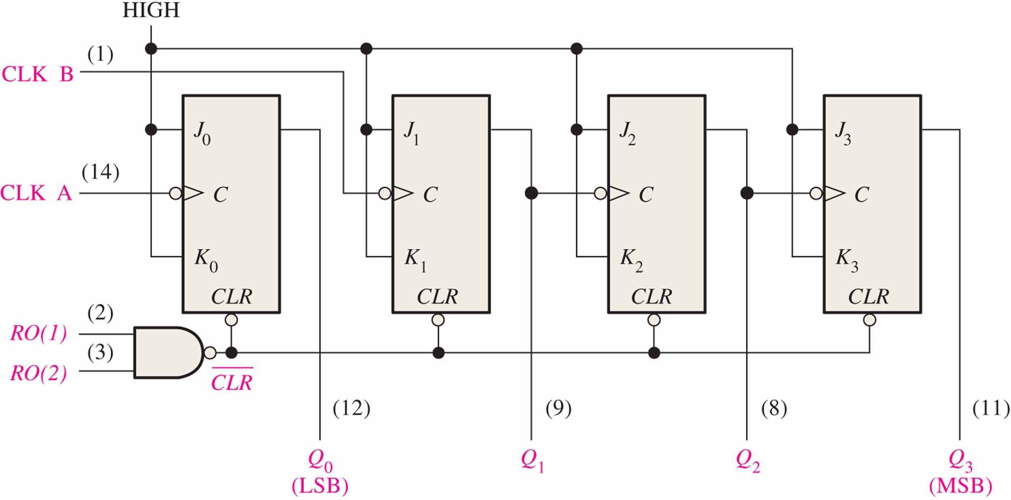
The 74LS93A Asynchronous Counter
The 74LS93A has one independent toggle J-K flip-flop driven by CLK A and three toggle J-K flip-flops that form an asynchronous counter driven by CLK B.

Slide 20
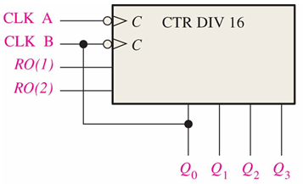
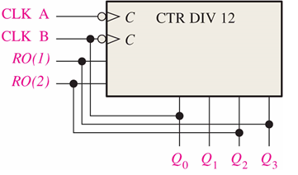
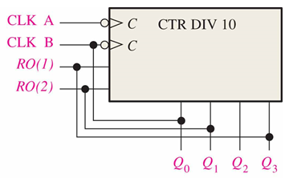
design modulus-N counter with 74LS93 {N=2..16}
(a)
(b)
(c)
(d)

Slide 21
Synchronous Counters 同步计数器
In a synchronous counter all flip-flops are clocked together with a common clock pulse.
Synchronous counters overcome the disadvantage of accumulated propagation delays, but generally they require more circuitry to control states changes.

Slide 22
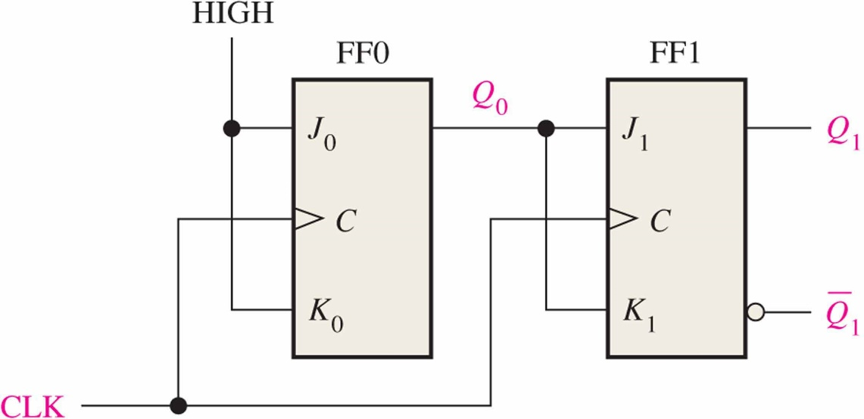
A 2-bit synchronous binary counter

Slide 23
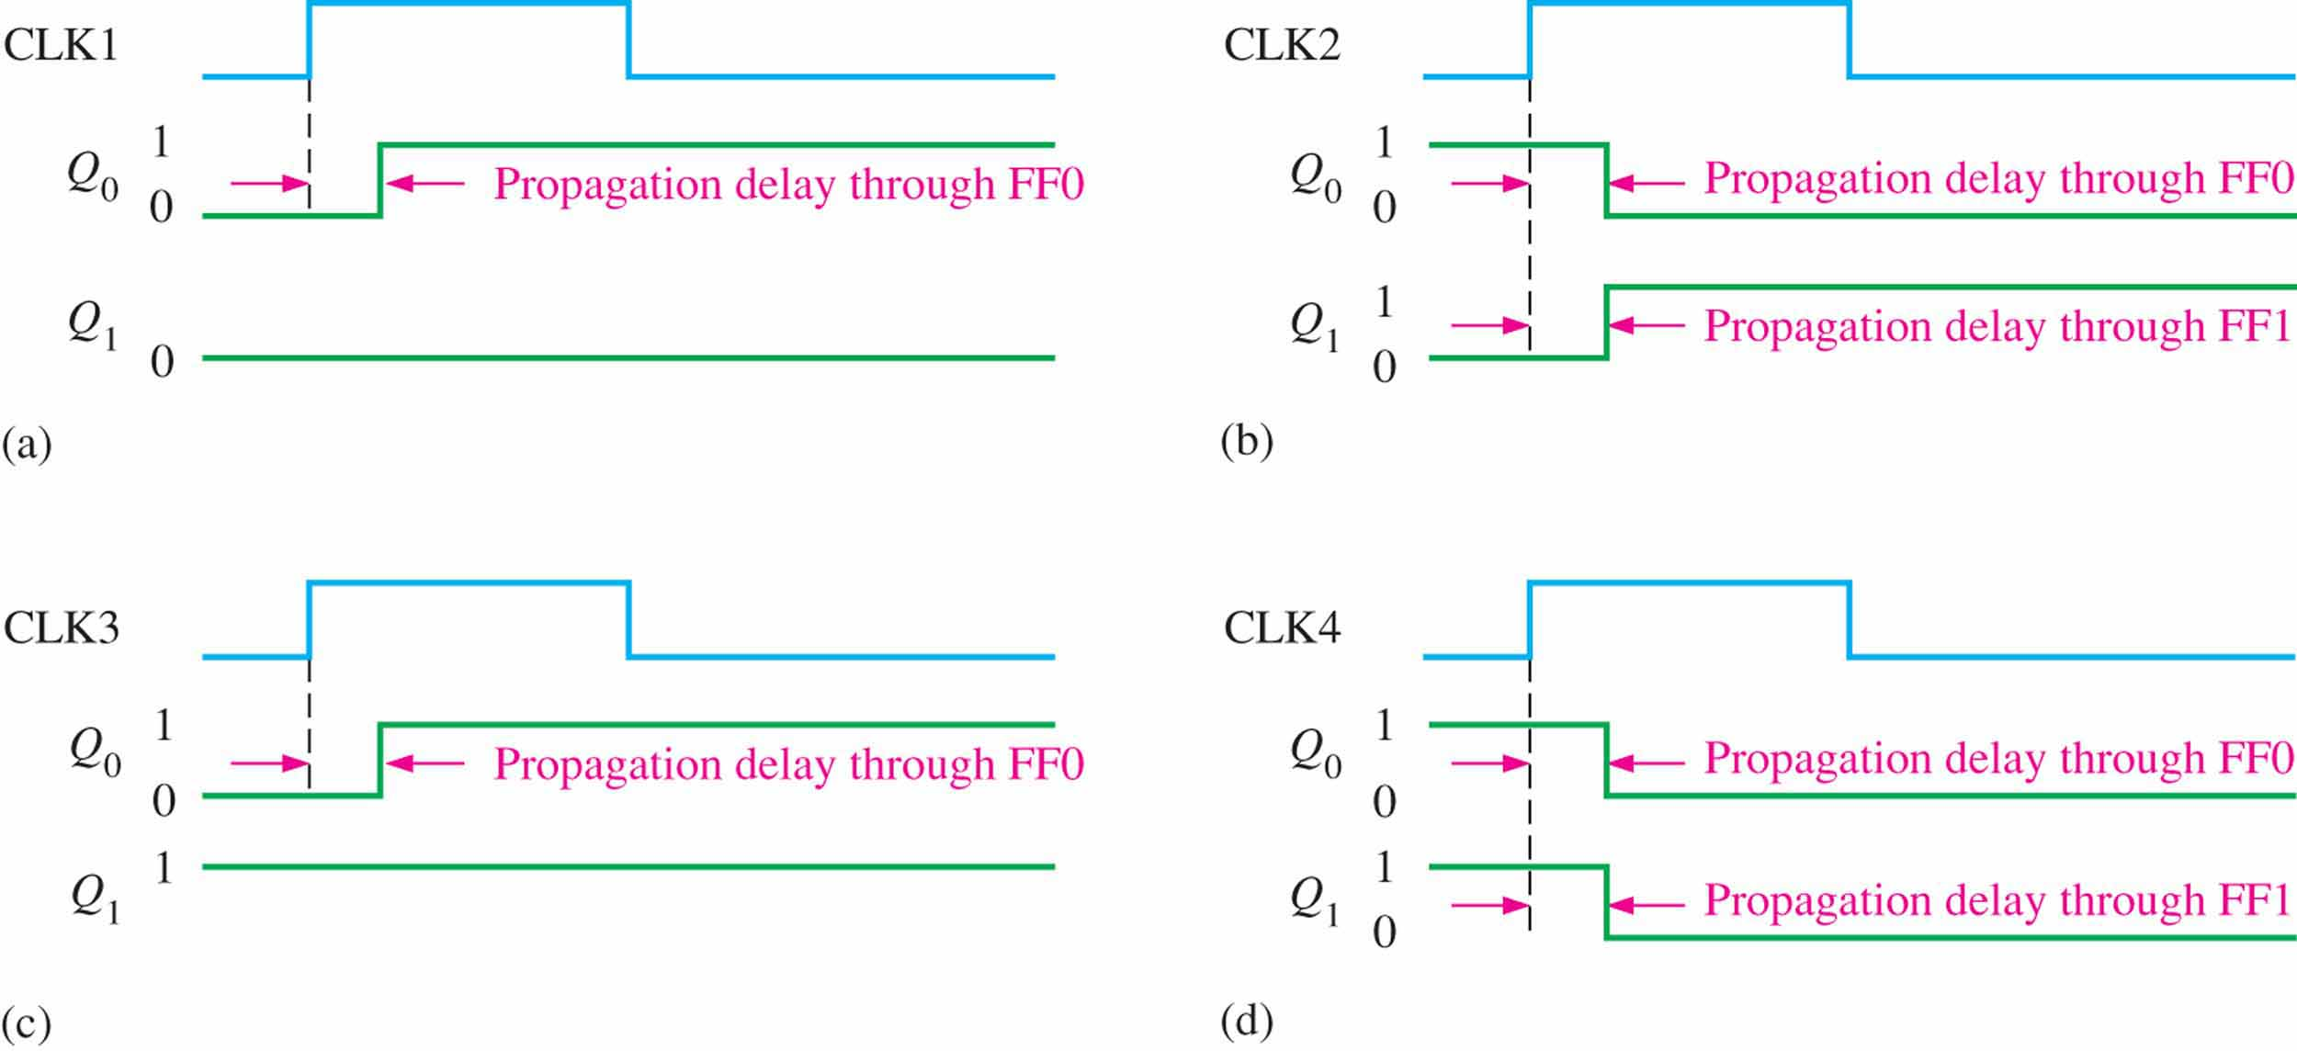
A 2-bit synchronous binary counter*

Slide 24
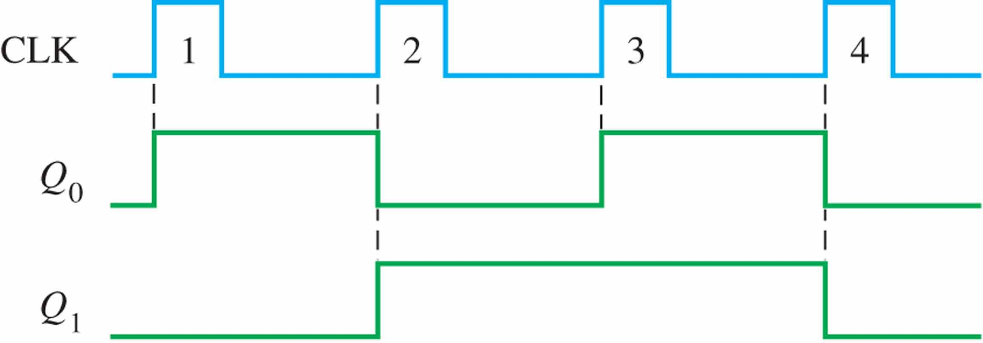
A 2-bit synchronous binary counter

Slide 25
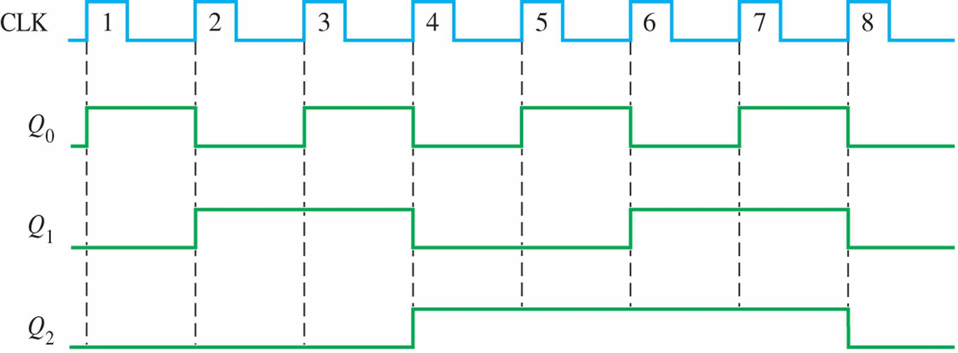
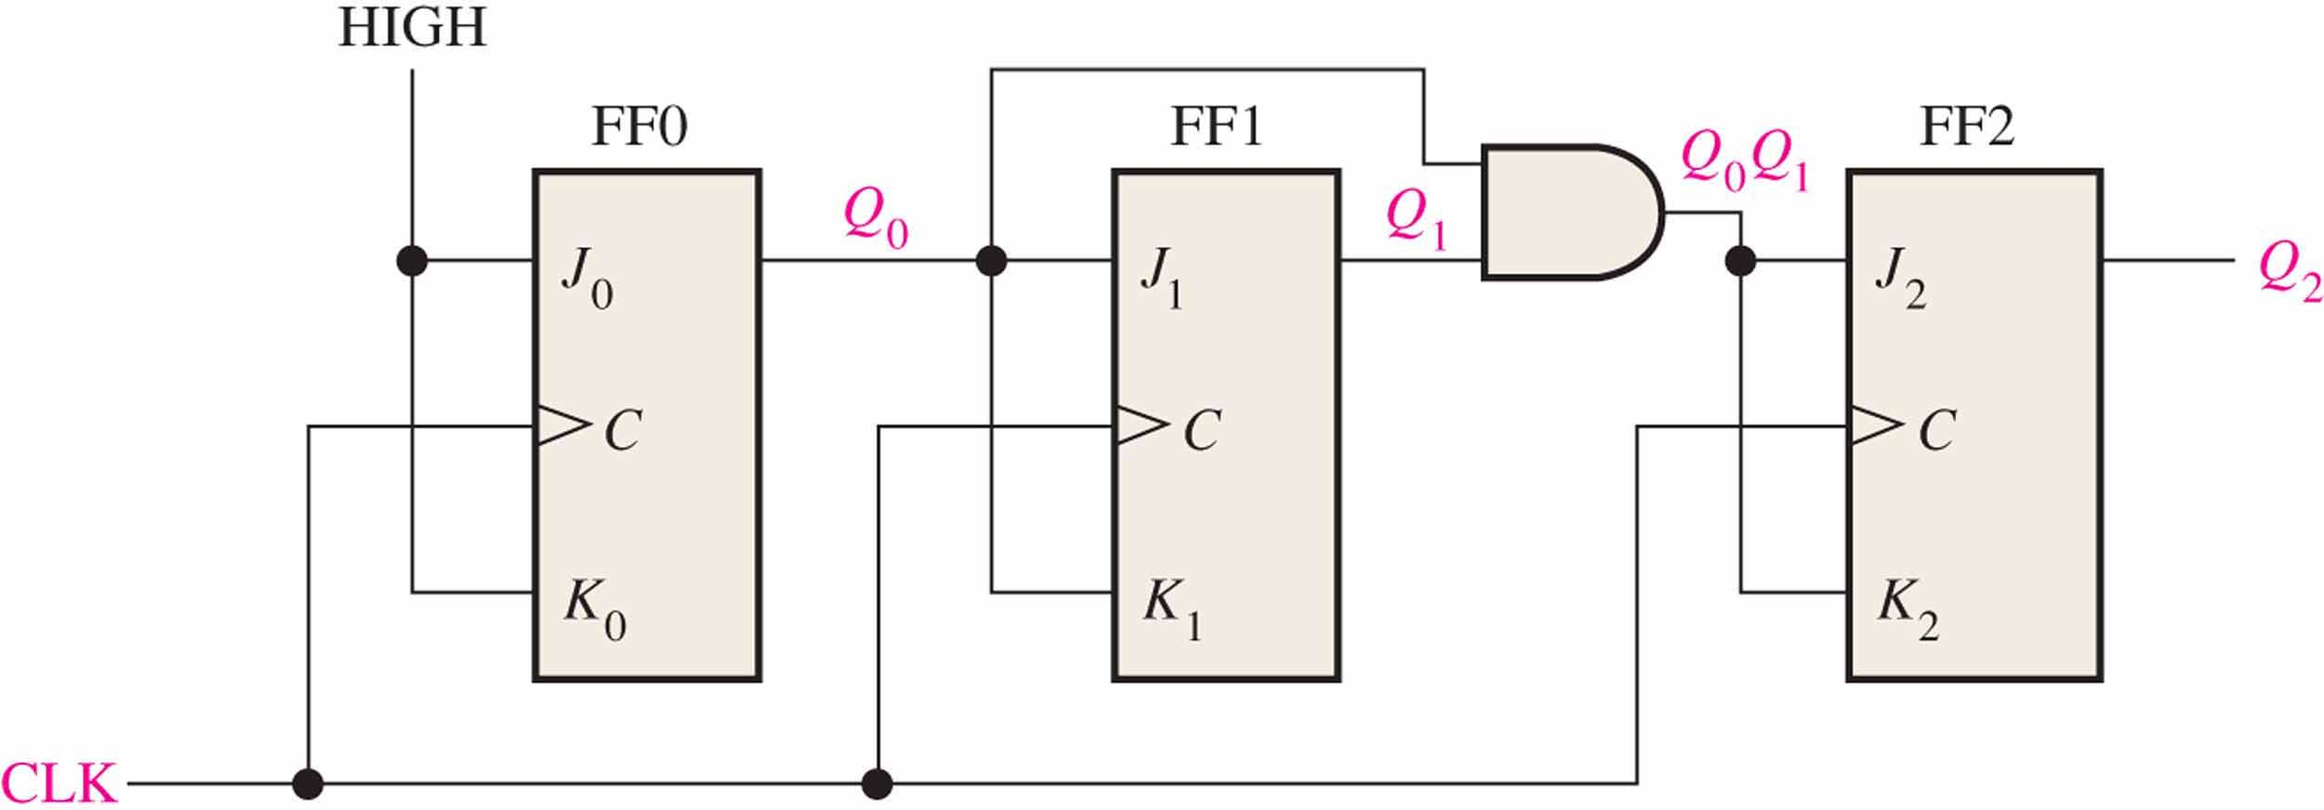
A 3-bit binary Synchronous Counters 三位同步计数器

Slide 26
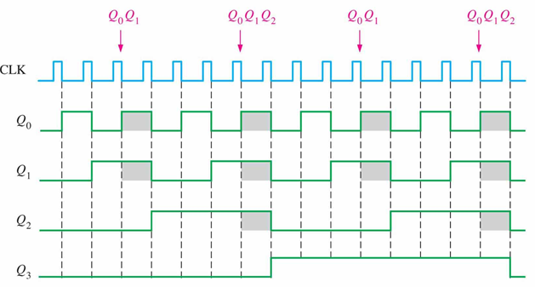
A 4-bit Synchronous Binary Counter

Slide 27
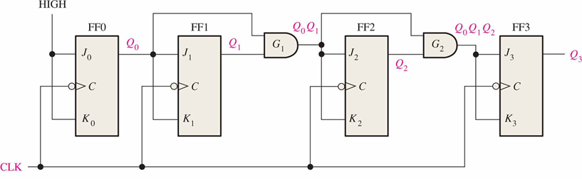
A 4-bit Synchronous Binary Counter
How about 5-bit ?
The 4-bit binary counter has one more AND gate than the 3-bit counter just described.

Slide 28
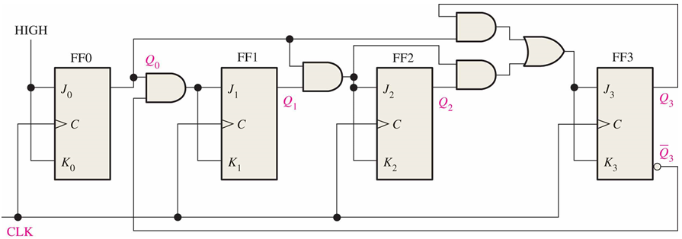
BCD Decade Counter
With some additional logic, a binary counter can be converted to a BCD synchronous decade counter. After reaching the count 1001, the counter recycles to 0000.
Detect 1001

Slide 29
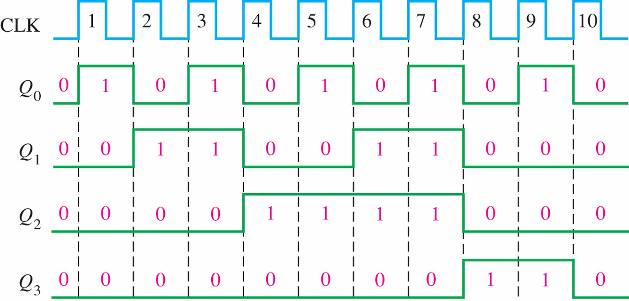
BCD Decade Counter
This gate detects 1001, and causes FF3 to toggle on the next clock pulse. FF0 toggles on every clock pulse. Thus, the count starts over at 0000.

Slide 30
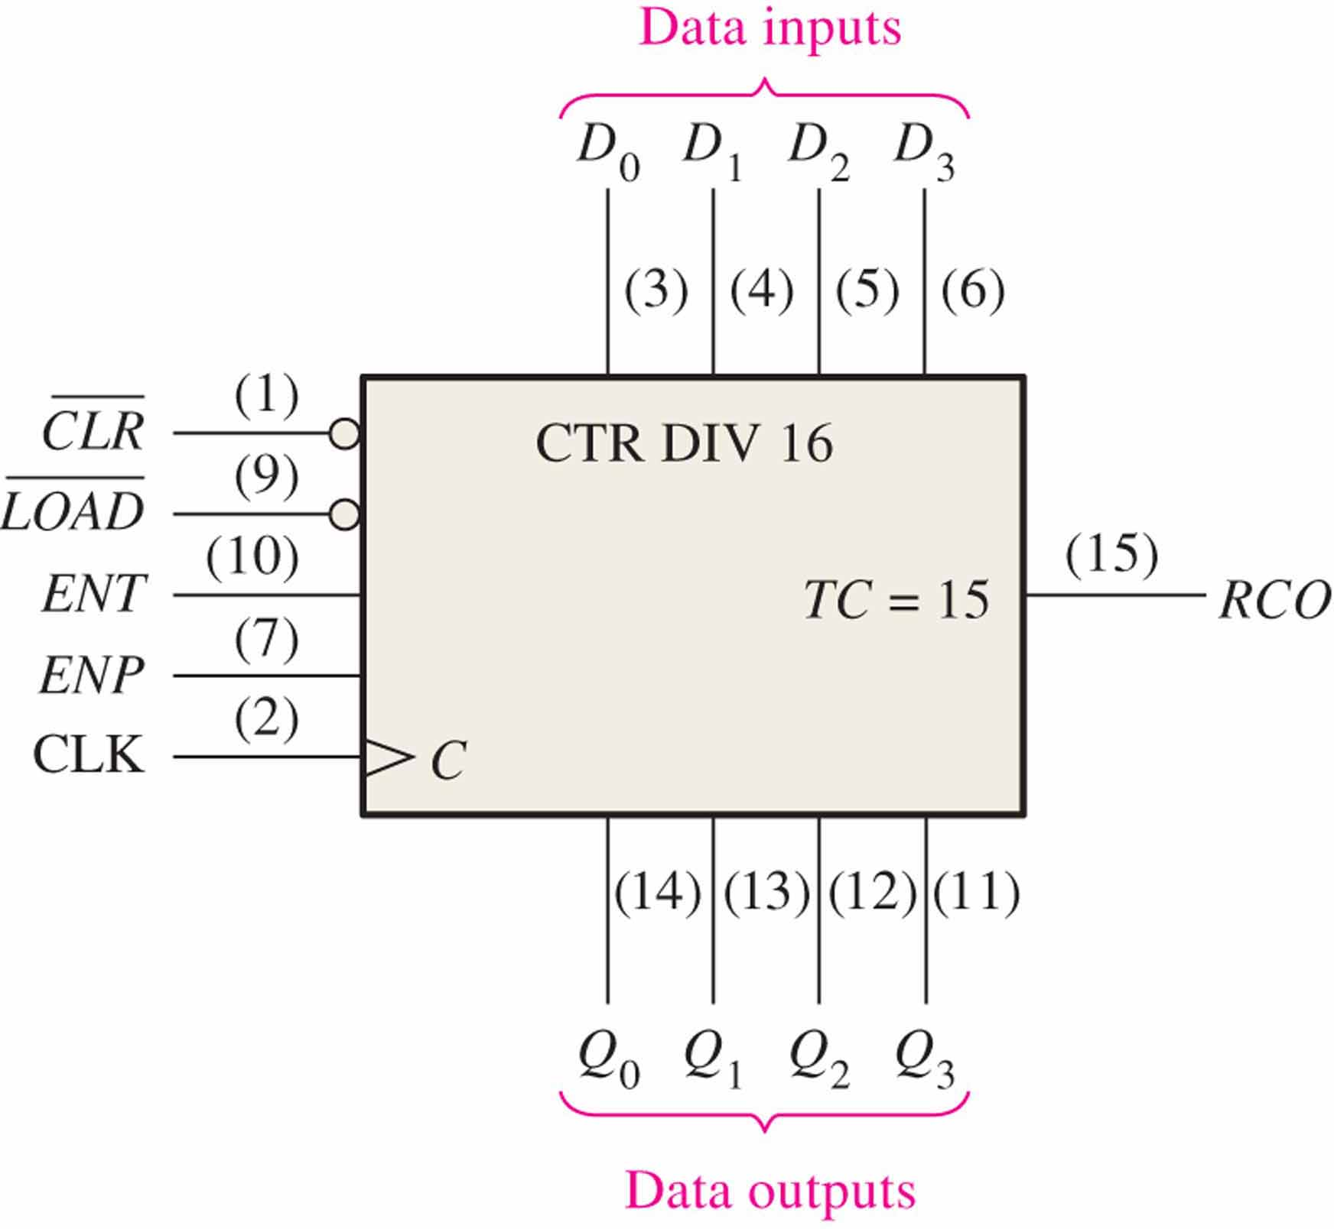

A 4-bit Synchronous Binary Counter
The 74LS163 is a 4-bit IC synchronous counter with additional features over a basic counter. It has parallel load, a $\overline{\text{CLR}}$ input, two chip enables, and a ripple count output that signals when the count has reached the terminal count.
Cascade signal

Slide 31
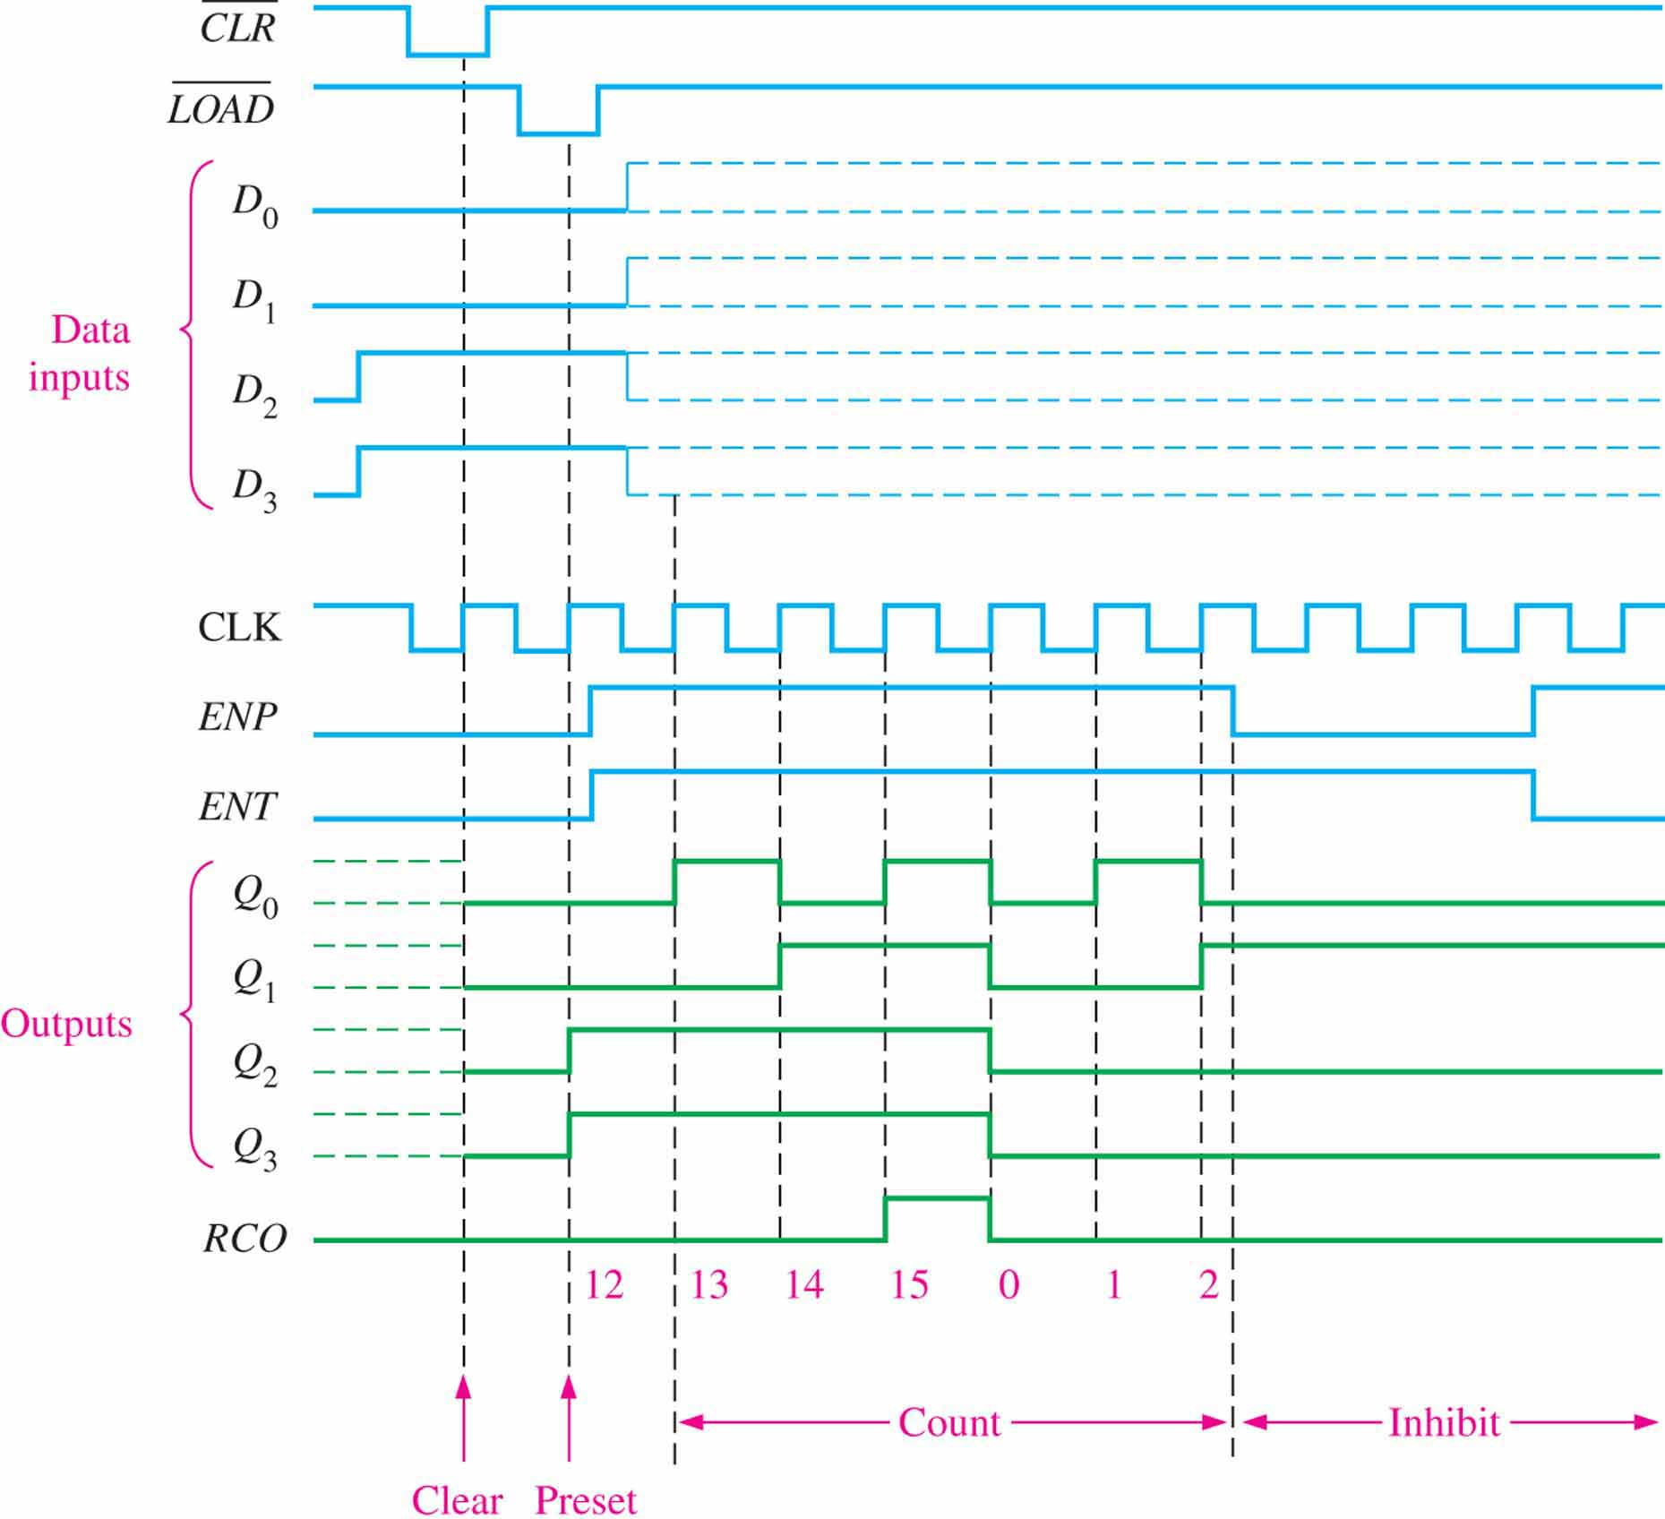
Time example for a 74hc163

Slide 32
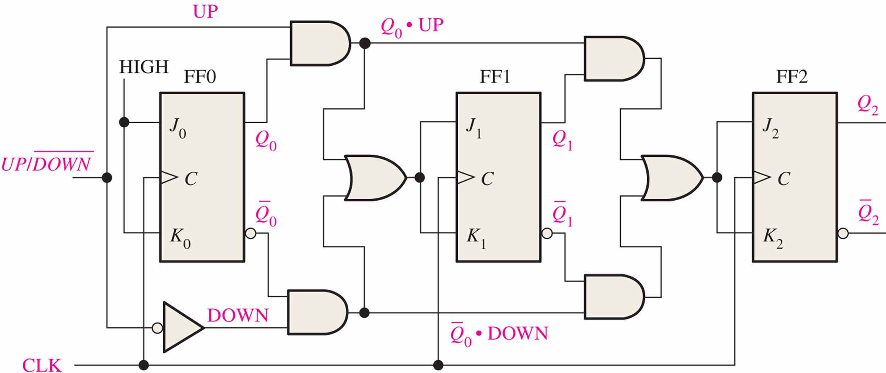
Up/Down Synchronous Counters 可逆同步计数器
0 | 0 | 0
0 | 0 | 1
0 | 1 | 0
0 | 1 | 1
1 | 0 | 0
1 | 0 | 1
1 | 1 | 0
1 | 1 | 1
An up/down counter is capable of progressing in either direction depending on a control input.

Slide 33
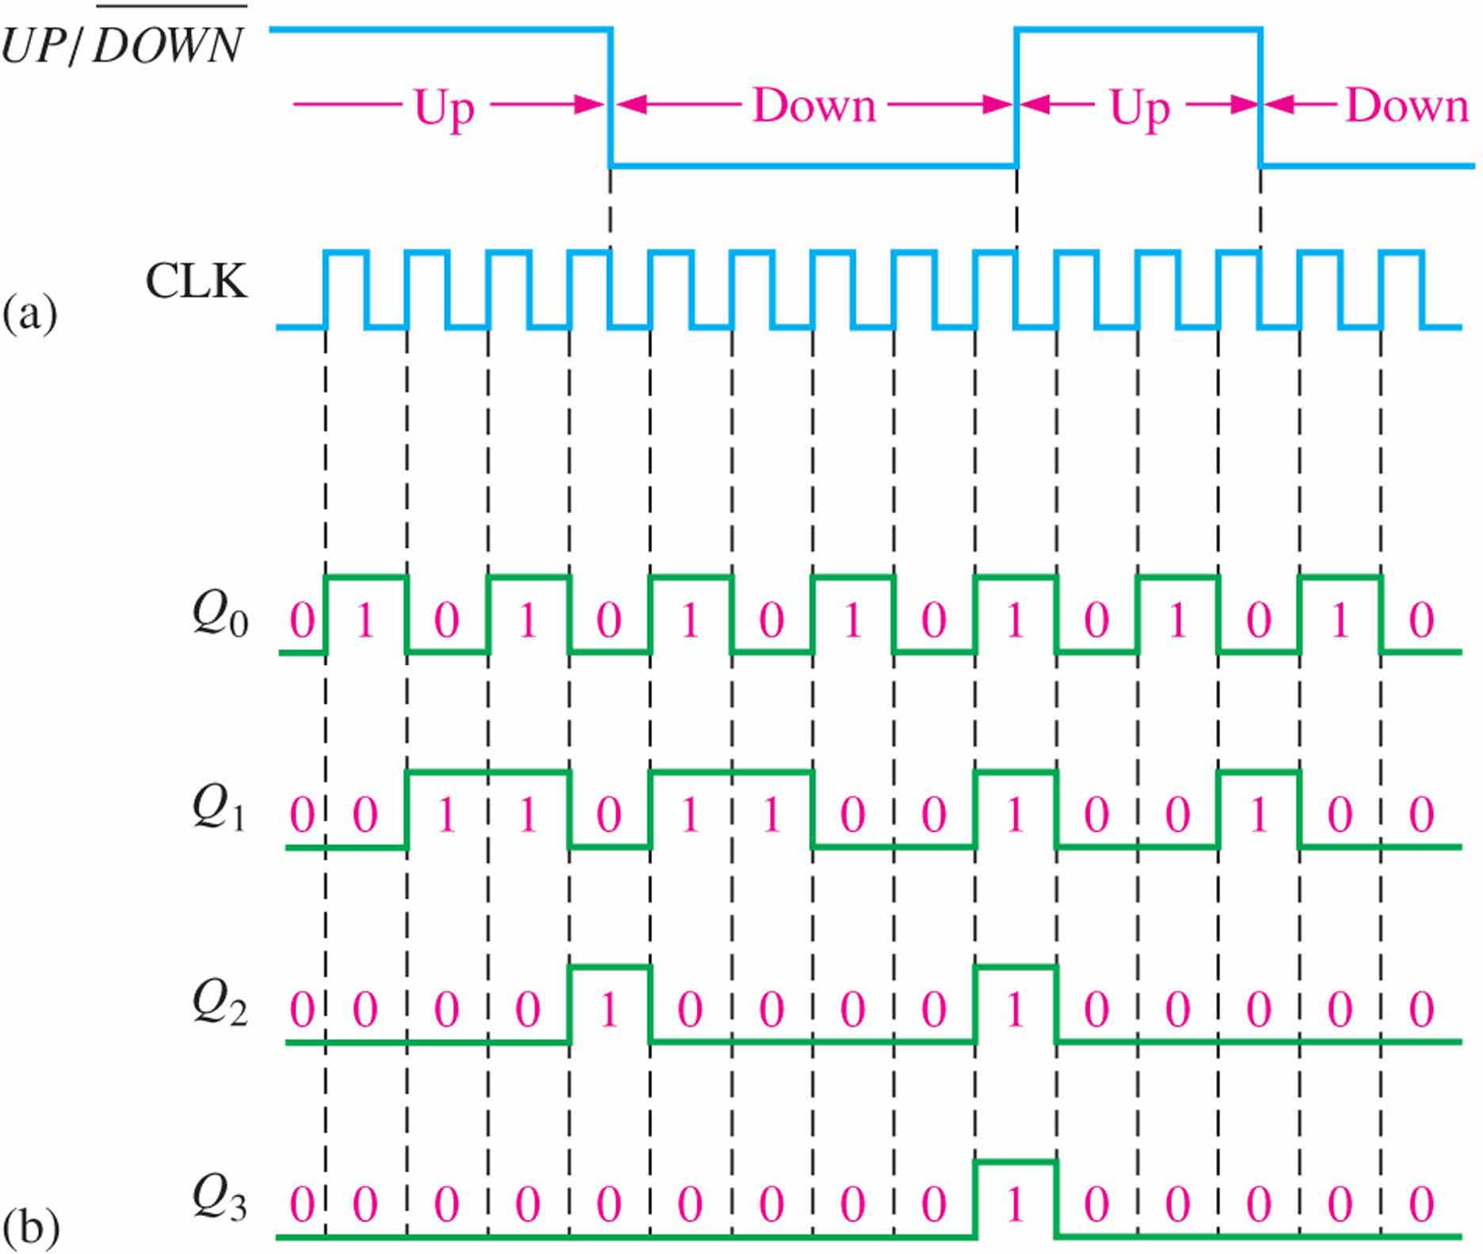
Up/Down Synchronous Counters

Slide 34
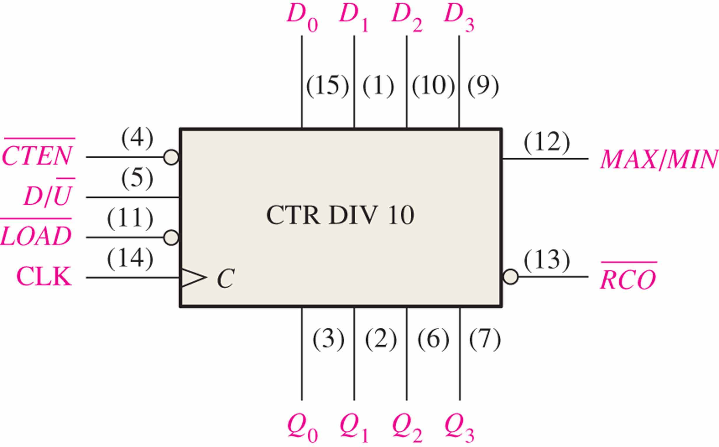

Up/Down Synchronous Counters
The 74HC190 is a high speed CMOS synchronous up/down decade counter with parallel load capability. It also has a active LOW ripple clock output ($\overline{\text{RCO}}$) and a MAX/MIN output when the terminal count is reached.

Slide 35
Sequential Circuits’ design

Slide 36
Input variable
Output variable
State variable
Excitation variable
State
State variables and states are related by the expression:
2^{x}=y
State variables
states

Slide 37
State Diagram 状态图
State Diagram: Graphical representation of a state table.
Graph node with label s denotes state s
Graph edge with label X denotes transition between two states when input X is applied
S
The state diagram of D flipflop
X
D=1
D=1
D=0
0
1
D=0

Slide 38
State Diagram of Mealy model
0/0
1/0
I/O
00
01
S1
S2
0/1
Reads as: When at state s1 and apply input I, we get output O and proceed to state s2.
0/1
0/1
1/0
10
1/0
11
1/0

Slide 39
State Diagram of Moore model
I
00,11
S1/O1
S2/O2
01,10
0/0
1/1
Reads as: When at state s1 with output
O1 and apply input I,
we proceed to state s2 with
Output O2.
01,10
00,11

Slide 40
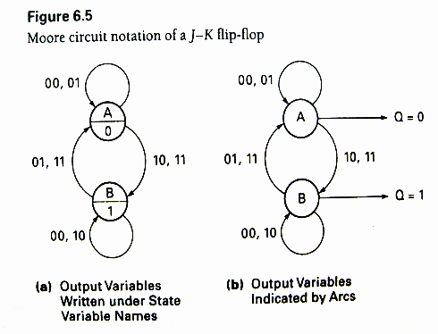
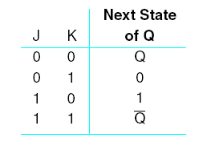
State Diagram

Slide 41
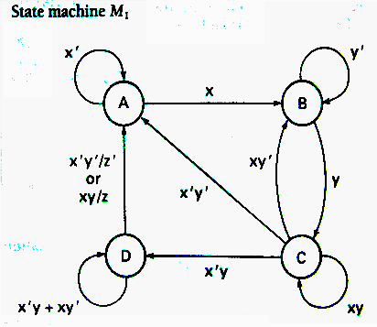

Slide 42
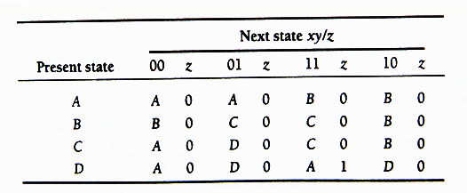
State Table 状态表
Enumerates the relationship between inputs, outputs, and states of the sequential circuit.

Slide 43
State Table

Slide 44
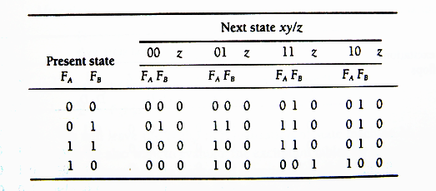

Transition Table 状态转换表
Each state is assigned a unique code.
$$2^{2}=4$$
F_{A} | F_{B} | State
0 | 0 | A
0 | 1 | B
1 | 1 | C
1 | 0 | D
4 state needs 2 state variables

Slide 45
Transition Table
Transition Table for state machine M₁

Slide 46
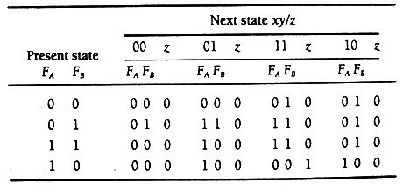
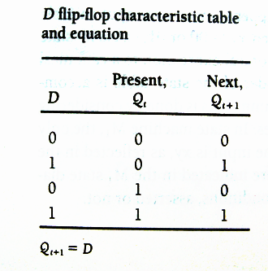
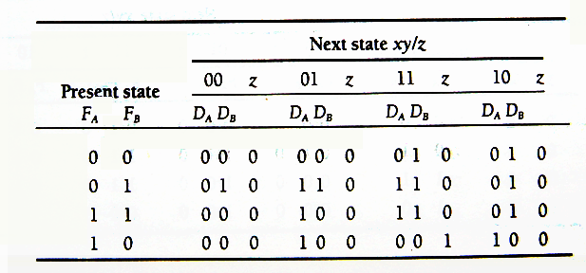
Excitation Table and Equations
Transition Table for state machine M1
D flip-flop used to realize circuit (two D flip-flops)
state machine M1 excitation table using D flip-flops

Slide 47
Excitation Table and Equations
D flip-flop used to realize circuit (two D flip-flops)
How to derive Equations?
D_{A}
D_{B}
Z

Slide 48
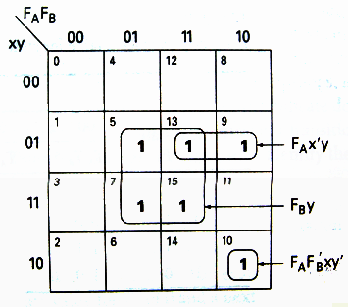
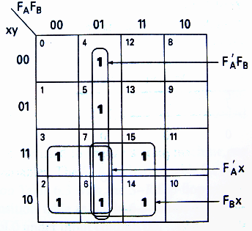
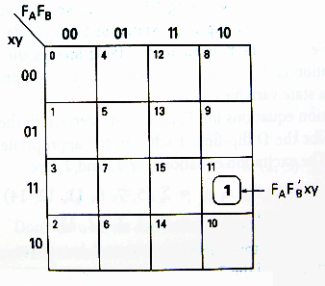
Excitation Table and Equations
D_{A} K-Map
D_{B} K-Map
Z K-Map
D_{A}=f(F_{A},F_{B},x,y)=Σ(5,7,10,13,15)=F_{A}F_{B}’xy’+F_{A}x’y+F_{B}y
D_{B}=f(F_{A},F_{B},x,y)=Σ(2,3,4,5,6,7,14,15)=F_{A}’F_{B}+F_{A}’x+F_{B}x
Z= f(F_{A},F_{B},x,y)=Σ(11)=F_{A}F_{B}’xy

Slide 49
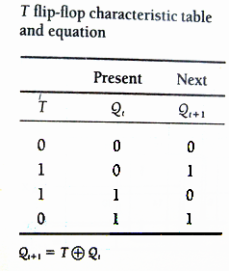
Excitation Table and Equations
Transition Table for state machine M₁
T flip-flop used to realize circuit (two T flip-flops)

Slide 50
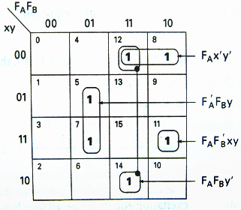
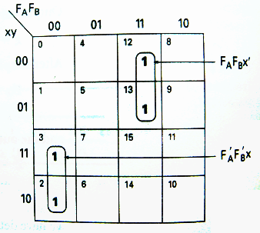
Excitation Table and Equations
T_{A} K-Map
T_{B} K-Map
T_{A}=f(F_{A},F_{B},x,y)=Σ(5,7,8,11,12,14)=F_{A}F_{B}’xy+F_{A}x’y’+F_{A}F_{B}y’+F_{A}’F_{B}y
T_{B}=f(F_{A},F_{B},x,y)=Σ(2,3,12,13)=F_{A}’F_{B}’x+F_{A}F_{B}x’

Slide 51
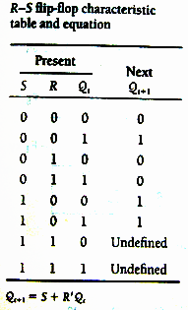
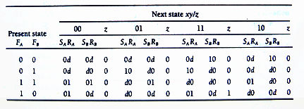
Excitation Table and Equations
Transition Table for state machine M₁
S-R flip-flop used to realize circuit (two SR flip-flops)
state machine M1 excitation table using S-R flip-flops

Slide 52
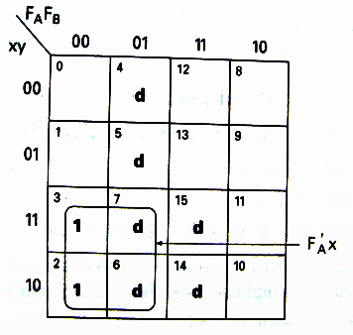
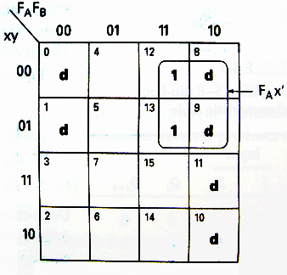
Excitation Table and Equations
S_{A} K-Map
R_{A} K-Map
S_{B} K-Map
R_{B} K-Map
S_{A}=f(F_{A},F_{B},x,y)=Σ(5,7) +Σd(9,10,13,15) =F_{B}y
R_{A}=f(F_{A},F_{B},x,y)=Σ(8,11,12,14) +Σd(0,1,2,3,4,6) =F_{B}’xy+x’y’+F_{B}y’
S_{B}=f(F_{A},F_{B},x,y)=Σ(2,3) +Σd(4,5,6,7,14,15) =F_{A}’x
R_{B}=f(F_{A},F_{B},x,y)=Σ(12,13) +Σd(0,1,8,9,10,11) =F_{A}x’

Slide 53
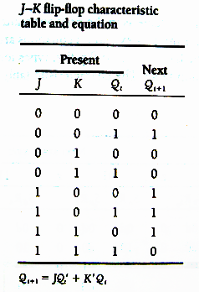
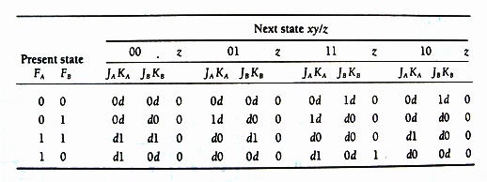
Excitation Table and Equations
Transition Table for state machine M₁

Slide 54
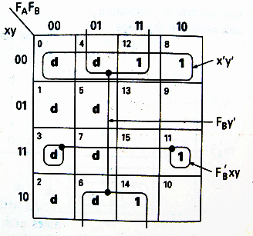
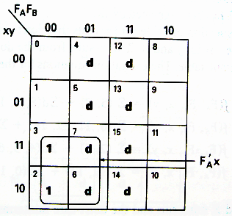
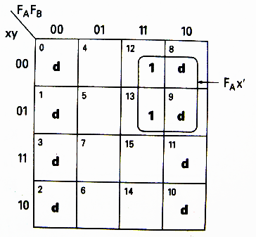
Excitation Table and Equations
J_{A} K-Map
K_{A} K-Map
J_{B} K-Map
K_{B} K-Map
J_{A}=f(F_{A},F_{B},x,y)=Σ(5,7) +Σd(8,9,10,11,12,13,14,15) =F_{B}y
K_{A}=f(F_{A},F_{B},x,y)=Σ(8,11,12,14) +Σd(0,1,2,3,4,6,7) =F_{B}’xy+x’y’+F_{B}y’
J_{B}=f(F_{A},F_{B},x,y)=Σ(2,3) +Σd(4,5,6,7,12,13,14,15) =F_{A}’x
K_{B}=f(F_{A},F_{B},x,y)=Σ(12,13) +Σd(0,1,2,3,8,9,10,11) =F_{A}x’

Slide 55
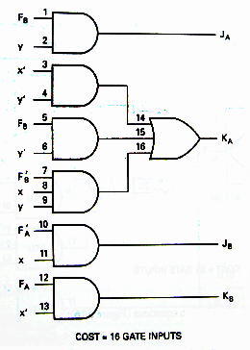
Excitation Realization Cost
J_{A}=F_{B}y
K_{A}=F_{B}’xy+x’y’+F_{B}y’
J_{B}=F_{A}’x
K_{B}=F_{A}x’

Slide 56

Excitation Realization Cost
S_{A}=F_{B}y
R_{A}=F_{B}’xy+x’y’+F_{B}y’
S_{B}=F_{A}’x
R_{B}=F_{A}x’

Slide 57

Excitation Realization Cost
T_{A}=F_{A}F_{B}’xy+F_{A}x’y’+F_{A}F_{B}y’+F_{A}’F_{B}y
T_{B}=F_{A}’F_{B}’x+F_{A}F_{B}x’

Slide 58

Excitation Realization Cost
D_{A}=F_{A}F_{B}’xy’+F_{A}x’y+F_{B}y
D_{B}=F_{A}’F_{B}+F_{A}’x+F_{B}x

Slide 59

Z= F_{A}F_{B}’xy

Slide 60
Construction of State Diagrams
The most challenging part of sequential circuit synthesis is the development of a state diagram from a verbal or written problem statement.
Construction of a state diagram in sequential design is analogous to the construction of a truth table in combinational logic design.

Slide 61
Example 1 Synchronous Decade Counter
Create the state diagram for a synchronous decade counter. The counter is to count up or down, in binary, depending on the value of a mode control input signal. When the mode control input M=0, the counter is to count up; when M=1, the counter is to count down. The counter is to repeat or cycle; that is to count from 0 to 9 and then start over if M=0 or count down from 9 to 0 if M=1. The counter output y is to be a 1 if counting up and the terminal count is reached. Another output z is to be a 1 at the terminal count if counting down.

Slide 62
Example 1 Synchronous Decade Counter
Solution:
10 states: 0..9
1 mode control, M=0/M=1，
output y, z
M'
M'
M'
M'
0
1
2
3
4
M/z
M
M
M
M'/y
M
M
M'
M
M
M
M
9
8
7
6
5
M'
M'
M'
M'

Slide 63
Example 2-1 Sequence Detector
Construct a Mealy state diagram that will detect a serial input sequence of 10110. The detection of the required bit pattern can occur in a longer data string and the correct pattern can overlap with another pattern. When the input pattern has been detected, cause an output z to be asserted high.
For example, let the input string be
x = 10110110110
z = 00001001001

Slide 64
Example 2-1 Sequence Detector
0/0
0/0
1/0
“1”
“10”
A
B
C
1/0
0/0
Starting state，waiting the first 1
1/0
0/1
0/0
1/0
“1”
“10”
“101”
“10110”
E
D
e.g.：input 10110110110
state BCDECDECDEC
output 00001001001
1/0
“1011”

Slide 65
Example 2-2: Sequence Detector
Design a Mealy serial bit-pattern detector that will detect the input sequence 01010 in a longer bit string. If the pattern is detected, then cause output Q to be active-high. If an 011 bit pattern occurs within the same serial data string, cause output P to be active high. If the 011 pattern occurs, cause the state machine to initialize and start over looking for the 01010 pattern. Overlapping 01010 patterns can occur.
If X = 00110101011101010101 then output
Q = 00000000100000001010
P = 00010000001000000000

Slide 66
Example 2-2: Sequence Detector
1/P
“011”，resets to state A
0
1
“0”
“01”
“0”
“01”
A
B
C
0
1
e.g.：input 00110101011
state：A-B-C-A-B-C-D-E-D-E-A
output：P：0010000001
Q：0000000100
0
1/P
0
“011”，resets to state A
“010”
“01”
“0101”
D
E
1
0/Q
“01010”

Slide 67
Synchronous Counter’s Design
The design procedure for a binary counter is the same as any other synchronous sequential circuit.
The primary inputs of the circuit are the CLK and any control signals (EN, Load, etc).
The primary outputs are the FF outputs (present state).
Most efficient implementations usually use T-FFs or JK-FFs. We will examine JK and D flip-flop designs.

Slide 68


J-K Flip Flop Design of a 4-bit Binary Up Counter

Slide 69


Slide 70


Slide 71


Slide 72
J-K Flip Flop Design of a 4-bit Binary Up Counter
J_{Q0} = 1
K_{Q0} = 1
J_{Q1} = Q₀
K_{Q1} = Q₀
J_{Q2} = Q₀ Q₁
K_{Q2} = Q₀ Q₁
J_{Q3} = Q₀ Q₁ Q₂
K_{Q3} = Q₀ Q₁ Q₂

Slide 73

J-K Flip Flop Design of a Binary Up Counter with EN and CO
EN = enable control signal.
0: counter remains in the same state,
1: it counts
CO = carry output signal, used to extend the counter to more stages
J_{Q0} = 1 · EN
K_{Q0} = 1 · EN
J_{Q1} = Q₀ · EN
K_{Q1} = Q₀ · EN
J_{Q2} = Q₀ Q₁ · EN
K_{Q2} = Q₀ Q₁ · EN
J_{Q3} = Q₀ Q₁ Q₂ · EN
K_{Q3} = Q₀ Q₁ Q₂ · EN
CO = Q₀ Q₁ Q₂ Q₃ · EN

Slide 74
Synchronous binary counters using D flip-flops
D_{Q0} = Q₀ ⊗ EN
D_{Q1} = Q₁ ⊗ ( Q0 · EN)
D_{Q2} = Q₂ ⊗ ( Q0 Q1 · EN )
D_{Q3} = Q₃ ⊗ ( Q0 Q1 Q2 · EN )
CO = Q₀ Q₁ Q₂ Q₃ · EN
JK-based design calls for 4 AND gates
D-based design calls for 4 AND and 4 XOR gates
JK-FF equations

Slide 75
Up-Down Binary Counter
HOMEWORK
Finish the design.
Design a BCD counter.
UD Q2 Q1 Q0 Q2 Q1 Q0
UD Q2 Q1 Q0 Q2 Q1 Q0
0 0 0 0 0 0 1
0 0 0 1 0 1 0
0 0 1 0 0 1 1
0 0 1 1 1 0 0
0 1 0 0 1 0 1
0 1 0 1 1 1 0
0 1 1 0 1 1 1
0 1 1 1 0 0 0
1 0 0 0 1 1 1
1 0 0 1 0 0 0
1 0 1 0 0 0 1
1 0 1 1 0 1 0
1 1 0 0 0 1 1
1 1 0 1 1 0 0
1 1 1 0 1 0 1
1 1 1 1 1 1 0
Up-Counter
Down-Counter

Slide 76

Binary Counter with Parallel Load
a 4-bit synchronous binary counter with parallel load capability
Load | Count | Operation
0 | 0 | Nothing
0 | 1 | Count
1 | X | Load

Slide 77
Arbitrary Sequence Counter 任意序列计数器
Given an arbitrary sequence, design a counter that will generate this sequence.
Procedure:
Derive state table/diagram based on give sequence
Simplify (using K-maps, etc)
Draw logic diagram

Slide 78
Example 1
Use D-FFs to draw the logic diagram for sequence generator (counter) for: 0 → 7 → 6 → 1 → 0
000 → 111 → 110 → 001 → 000

Slide 79
Example 1

Slide 80
Sequential Circuits’ analysis

